Slide 1
STORAGE
FUNDAMENTALS

Slide 2
Soumya Gupta (152915)
Fiber Channel
Aastha Verma (152537)
Direct Attached Storage
3. Samiti Rahul (152907)
Network Attached Storage
4. Jabbireddy Gireesha (152659)
Storage Area Network
5. Naredla Gangavamshi (152851)
Raid levels

Slide 3
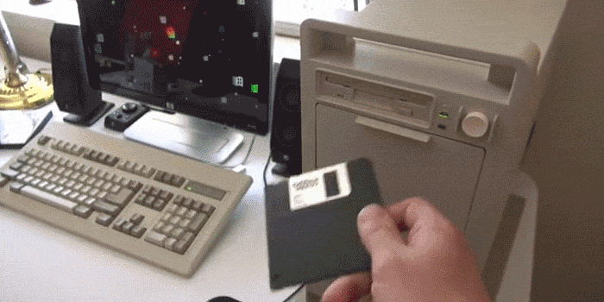
STORAGE TYPES

Slide 4
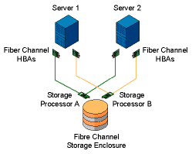
Fiber channel
A high-speed network technology providing in-order, lossless delivery of raw block data.
Typically runs on optical fiber cables within and between data centers, but can also run on copper cabling.
Fiber Channel Protocol(FCP) is a protocol layer that transports SCSI commands over fiber channel networks.

Slide 5
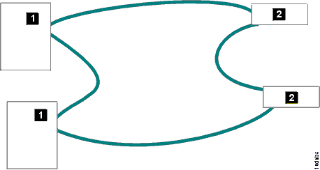
FC Arbitrated loop
Fibre Channel Arbitrated Loop (FC-AL) is a ring topology that enables you to interconnect a set of nodes.
The maximum number of ports is 127.
The storage unit supports FC-AL as a private loop. It does not support the fabric-switching functions in FC-AL.
1.Host system
2.Storage unit

Slide 6
WHAT IS DAS?
Direct attached storage (DAS), also called direct attach storage, is digital storage that is attached directly to a computer or a server. In other words, DAS isn't part of a storage network.
The most familiar example of DAS is the internal hard drive in a laptop or desktop PC.
DAS can refer to a single drive or a group of drives that are connected together. In addition, DAS devices can be housed inside a PC or server or outside the PC or server.
DAS creates data islands, because data cannot be shared with other servers.

Slide 7
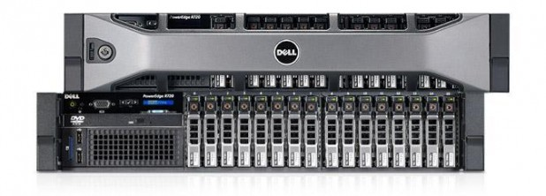
Most PCs and many servers come with DAS already installed, and if you want to add more direct attached storage, generally all you need to purchase is a storage device and possibly a cable.
Connecting additional DAS devices to servers is a little more complicated than adding DAS to a PC, but it is generally simpler than connecting SAN or NAS devices because it doesn't require you to design a network or purchase hardware like routers and switches.

Slide 8
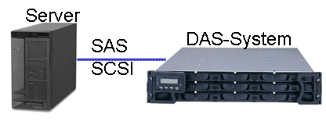
DAS Technology:
DAS devices can utilize traditional spinning hard disk drives or solid state media. Hard disk drives (HDDs) are less expensive than solid state drives (SDDs) on a per gigabyte basis. However, they aren't as fast as SDDs.
The majority of DAS devices sold today use hard disk drives, although SSDs and hybrid devices are becoming more popular, particularly for applications where performance is paramount, such as Big Data analytics.

Slide 9
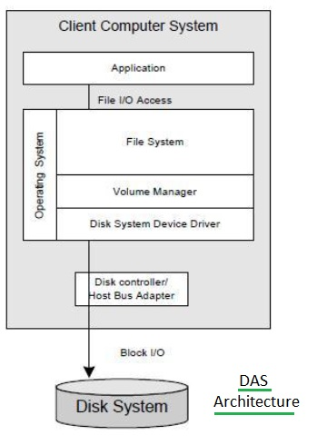
DAS Software Architecture

Slide 10
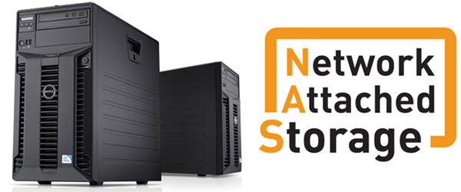
A storage device, which is attached directly to a network is called as Network Attached Storage.
NAS provides file access services to computer system and acts like a storage element-SNIA(Storage Network Industry Association).

Slide 11
Introduction
NAS is used to access and to store different type of data over a network.
NAS systems are networked appliances which contain one or more storage drives, often arranged into logical, redundant storage containers .
Have its own LAN IP address for RAID configuration, which is attached to the administrator computer that provide applications to network workplace clients.
Provide access to files using network file sharing protocols such as NFS, SMB/CIFS, or AFP.

Slide 12
NAS COMPONENTS
NAS Functions
Data reception component
Data interception component
Intermediate component
Data identification component
File sharing
Data backup/disaster recovery
Network printing
Multimedia file sharing
Media server

Slide 13
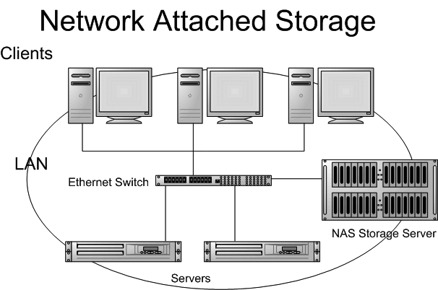

Slide 14
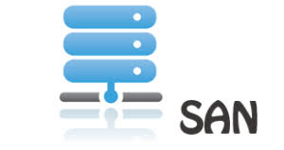
WHAT IS SAN?
Storage Area Network (SAN) is a high-speed network of storage devices that also connects those storage devices with servers. It provides block-level storage that can be accessed by the applications running on any networked servers.
SANs are particularly helpful in backup and disaster recovery settings.
Within a SAN, data can be transferred from one storage device to another without interacting with a server. This speeds up the backup process and eliminates the need to use server CPU cycles for backup.

Slide 15
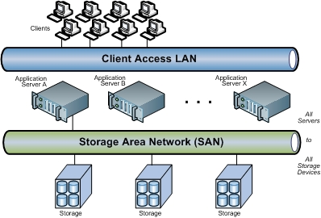
SANs utilize Fibre Channel technology or other networking protocols that allow the networks to span longer distances geographically. That makes it more feasible for companies to keep their backup data in remote locations.
Fibre Channel is currently the most widely used communication protocol for SANs.

Slide 16
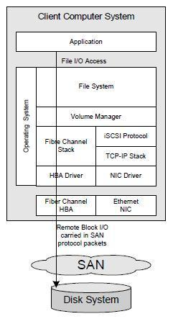
SAN Software Architecture

Slide 17
LOGICAL UNIT NUMBER
In computer storage, a logical unit number, or LUN, is a number used to identify a logical unit, which is a device addressed by the Storage Area Network protocols which encapsulate SCSI, such as Fibre Channel or iSCSI.
A LUN may be used with any device which supports read/write operations, such as a tape drive, but is most often used to refer to a logical disk as created on a SAN.
The logical unit may be a part of a storage drive, an entire storage drive, or all of parts of several storage drives such as hard disks, solid-state drives or tapes, in one or more storage systems.
The capacity limit of a LUN varies by system.

Slide 18
TYPES OF LUNs
Mirrored LUN:
Fault-tolerant LUN with identical copies on two physical drives for data redundancy.
Concatenated LUN:
Consolidates several LUNs into a single logical unit or volume.
Striped LUN:
Writes data across multiple physical drives, potentially enhancing performance by distributing I/O requests across the drives.

Slide 19
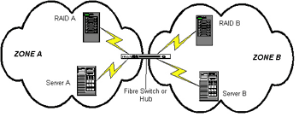
ZONING
SAN zoning is a method of arranging Fibre Channel devices into logical groups over the physical configuration of the fabric.
SAN zoning may be utilized to implement compartmentalization of data for security purposes.
Each device in a SAN may be placed into multiple zones.

Slide 20
iSCSI
In computing, iSCSI is an acronym for Internet Small Computer Systems Interface, an Internet Protocol (IP)-based storage networking standard for linking data storage facilities. It provides block-level access to storage devices by carrying SCSI commands over a TCP/IP network.
The protocol allows clients to send SCSI commands to storage devices on remote servers.
It mainly competes with Fibre Channel, but unlike traditional Fibre Channel which usually requires dedicated cabling, iSCSI can be run over long distances using existing network infrastructure.

Slide 21
Storage
Raid levels

Slide 22
RAID
RAID used to stand for redundant array of inexpensive/independent disks.
RAID is a way of grouping individual physical drives together to form one bigger drive called a RAID set.
Notes:
Usar para separador de capitulos . Seria bom ter esta versao em vermelho e verde tb..

Slide 23
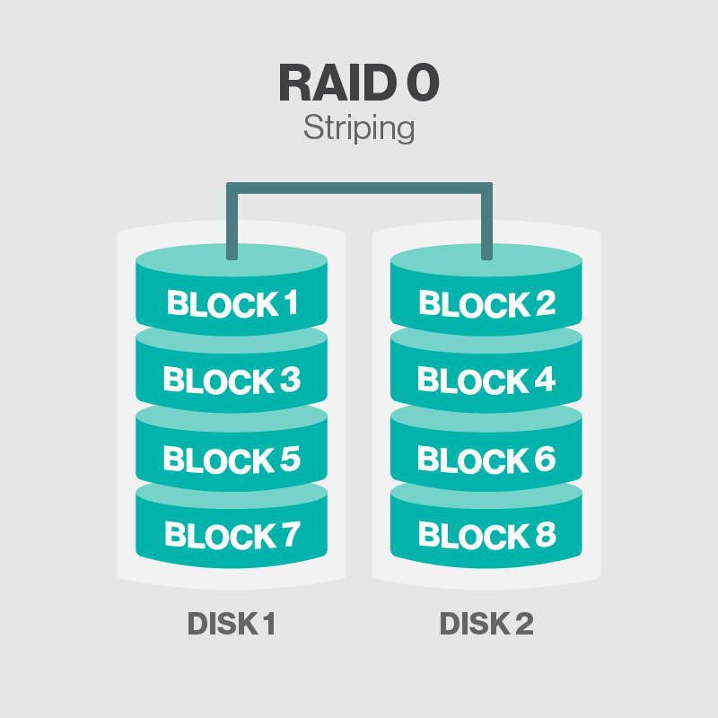
RAID 0
RAID 0 is called disk striping

Slide 24
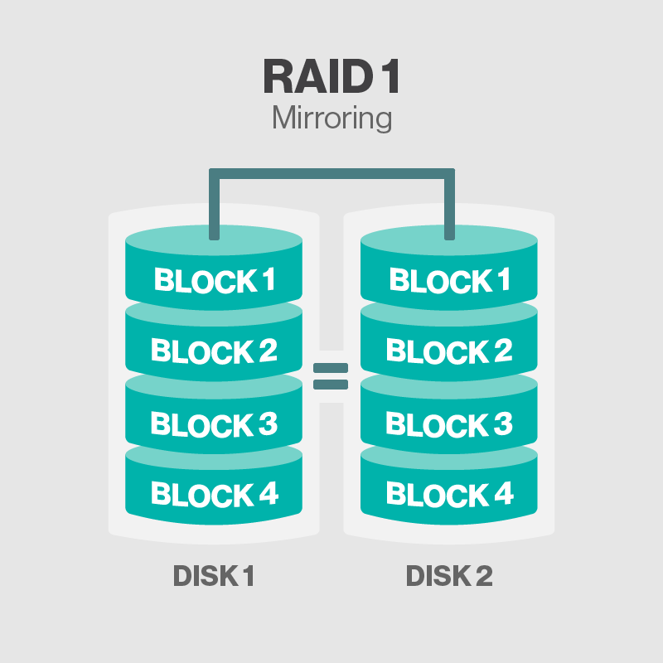
RAID 1
RAID 1 is also called disk mirroring

Slide 25
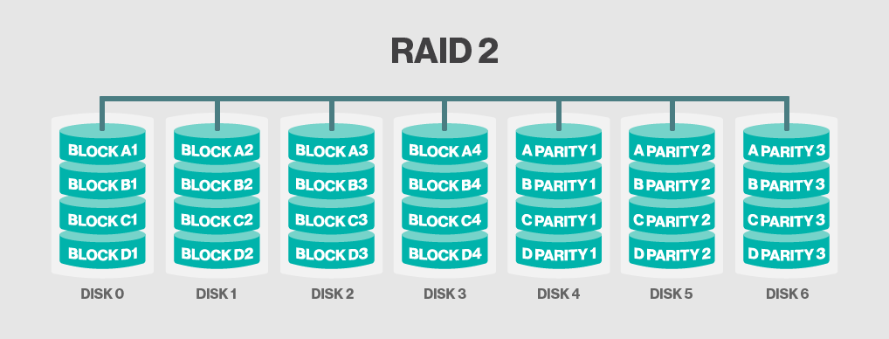
RAID 2
RAID 2 stripes data at the bit level using hamming code

Slide 26
Hamming Code
Redundant bits
2^r > m + r + 1
where, r = redundant bit, m = data bit
Parity bits
Hamming code is a set of error-correction codes that can be used to detect and correct the errors
It is developed by R.W. Hamming for error correction
Even parity bit
Odd Parity bit

Slide 27
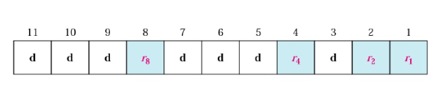
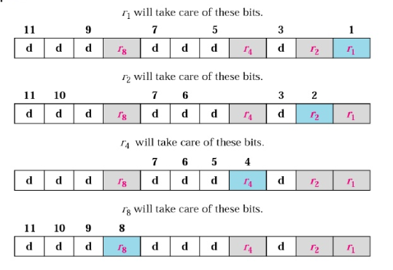
Redundant bit calculation

Slide 28
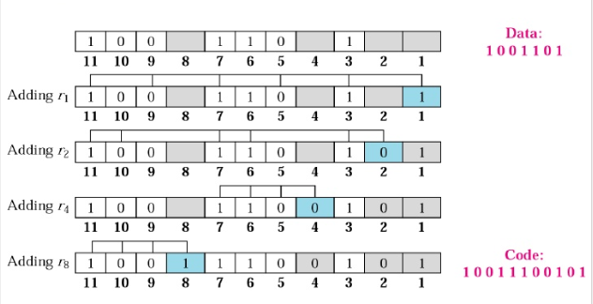

Slide 29
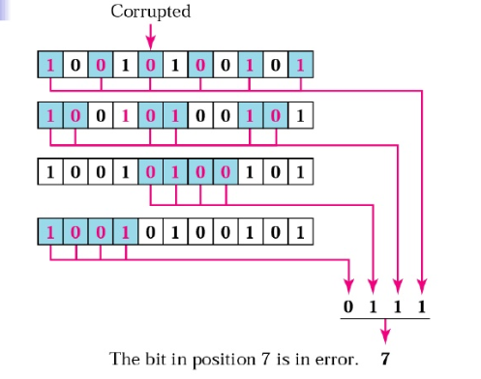
Code sent was 10011100101
Code receives as 10010100101

Slide 30
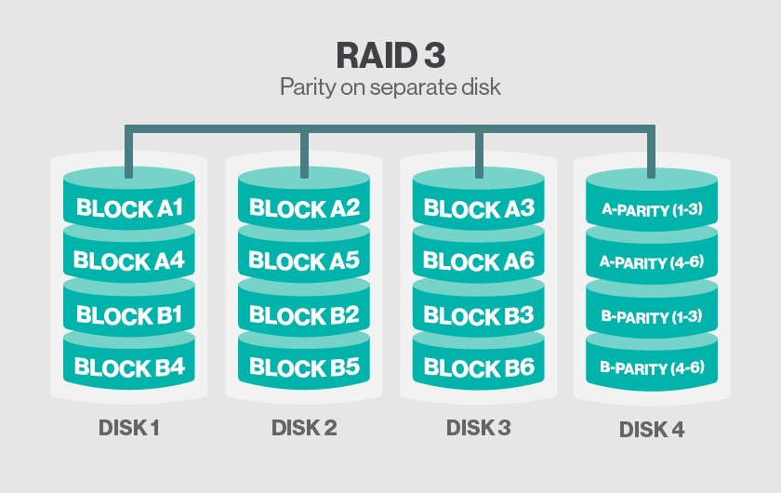
RAID 3
RAID 3 uses Parity on Separate Disk

Slide 31
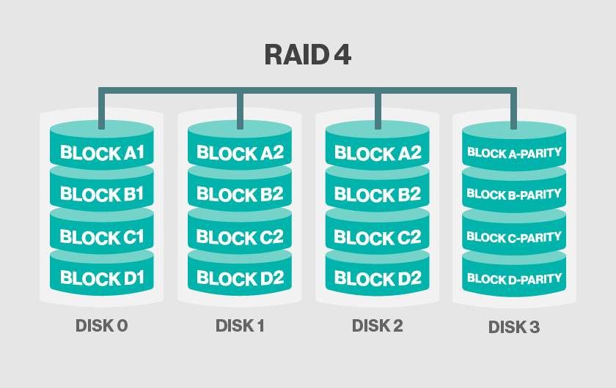
RAID 4
RAID 4 uses separate parity and block level Striping

Slide 32
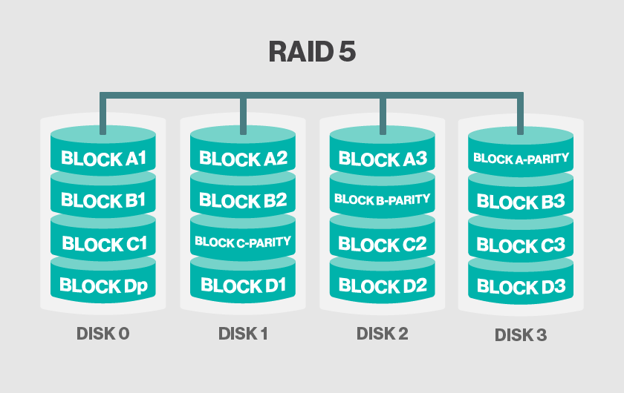
RAID 5
RAID 5 uses disk striping with parity

Slide 33
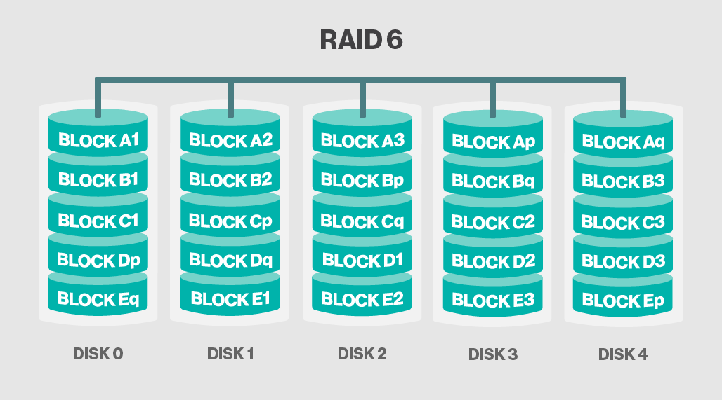
RAID 6
RAID 6 increases reliability by utilizing two parity stripes

Slide 34
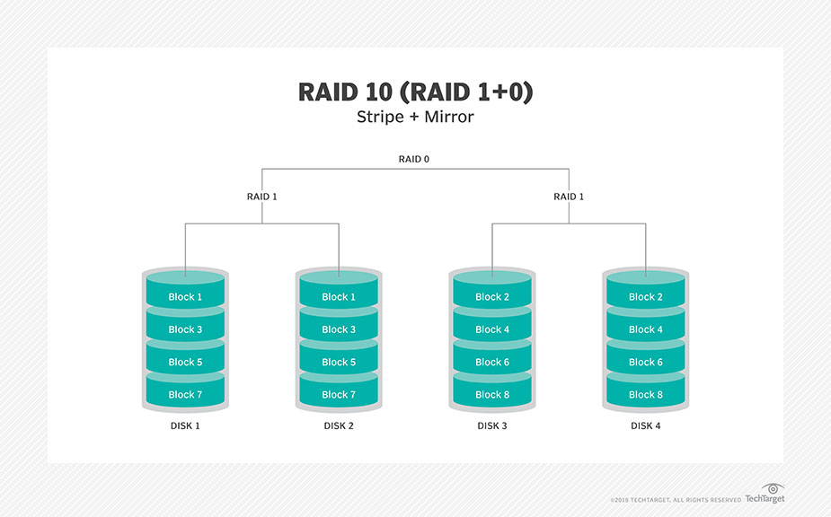
RAID 10
RAID 10 uses a combination of disk mirroring and disk Striping

Slide 35
THANK YOU

